Slide 1
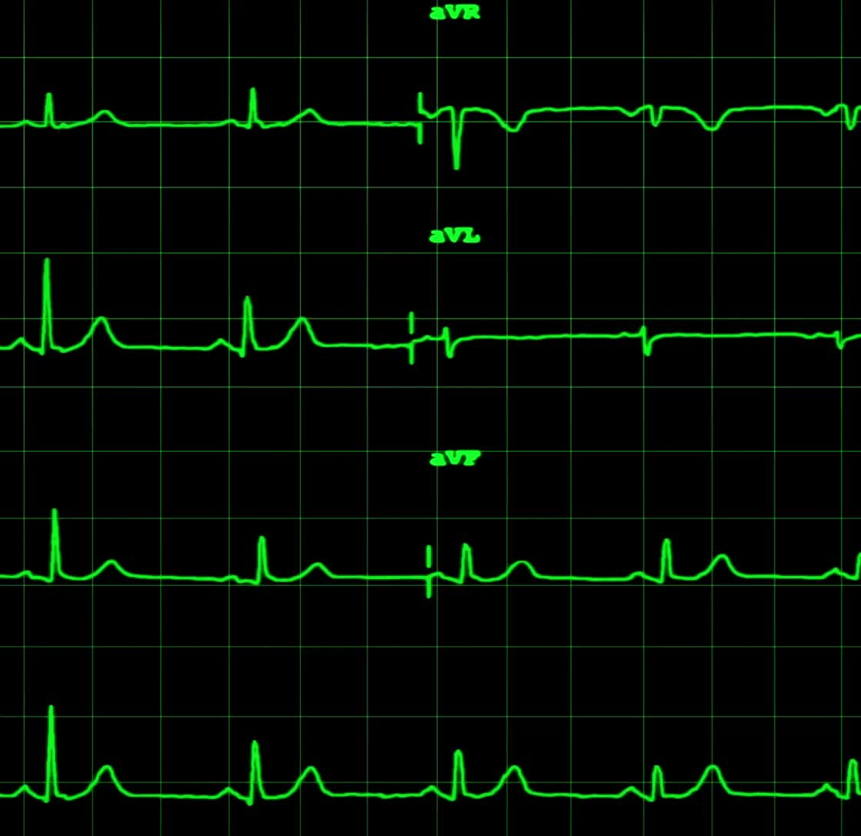
The Cardiovascular (or CV) System: AMI
Anna H. Haro, Pharm.D.
Westside High School
March 2022

Slide 2
LEARNING Objectives TEKS: §130.231.(c)(1)(A, & B) and §130.231.(c)(2)(A, B, C, F, & G) & (3)(B)
Students will apply prior knowledge and skills from Biology to develop new knowledge and skills of the Cardiovascular System.
Students will develop medical terminology of the Cardiovascular System related to an AMI.
Students will explain the physiology of an AMI.
Students will identify the s/sx and risk factors of an AMI.
Students will evaluate the DX, TX, and PX including secondary prevention of an AMI.

Slide 3
LEARNING Objectives TEKS: §130.231.(c)(1)(A, & B) and §130.231.(c)(2)(A, B, C, F, & G) & (3)(B)
Los estudiantes aplicarán conocimientos y habilidades previos de biología para desarrollar nuevos conocimientos y habilidades del sistema cardiovascular.
Los estudiantes desarrollarán la terminología médica del Sistema Cardiovascular relacionada con un AMI.
Los estudiantes explicarán la fisiología de un AMI.
Los estudiantes identificarán el s/sx y los factores de riesgo de un AMI.
Los estudiantes evaluarán el DX, TX y PX, incluida la prevención secundaria de un AMI.

Slide 4
Recap: different CVD
CVD or Cardiovascular Disease describes a large category of dx that affects the function or/and structure of the heart and blood vessels or any part of the CV system. Examples:
AMI – Acute Myocardial Infarction, aka heart attack
HTN – hypertension, also known as high ________ _________
CAD: Coronary Artery Disease or Dyslipidemia – high cholesterol
ASCVD: Atherosclerotic Cardiovascular Disease – both coronary ASCVD and non-coronary ASCVD
Cardiac Arrhythmias
Valvular disorders
Heart Failure
PVD and PAD

Slide 5
AMI
Today’s focus will shift to a heart attack or an acute myocardial infarction.
First, let’s look at what causes the heart attack to occur.
https://youtu.be/cLOga_mDwvs
Video from: the National Heart Foundation of New Zealand (https://www.heartfoundation.org.nz/your-heart/heart-conditions/about-heart-attacks)

Slide 6
The link between CAD and AMI
Recall:
CAD or Coronary artery disease is caused by a build-up of cholesterol plaques in the blood vessels of the heart, specifically the coronary arteries. These arteries supply blood and oxygen (and other nutrients) to the heart.
CAD is the main cause of AMI. What is an AMI?
CAD is caused by dyslipidemia or high cholesterol.

Slide 7
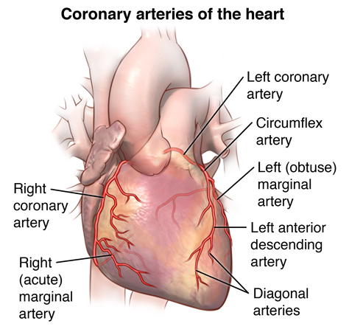
Coronary Arteries
These are the arteries that supply blood, oxygen, and nutrients to the heart (note, these branch off from the aorta and carry oxygenated blood away from the inside of the heart to the heart muscle and exterior heart walls.
If any of these are blocked due to cholesterol plaques or blood clots, then the pt will experience an AMI.
Image from: https://www.hopkinsmedicine.org/health/conditions-and-diseases/anatomy-and-function-of-the-coronary-arteries

Slide 8
The link between CAD and AMI
Dyslipidemia is the 2nd most common chronic disease in the United States affecting more than 100 million patients over 20 years old. What is the most common chronic dx?
High cholesterol is diagnosed based on lab values: total cholesterol in the blood, or TC along with LDL, HDL, and TG. (Be sure to know these abbreviations.)
Are these values objective or subjective?

Slide 9
Cholesterol Lab Values: memorize
Cholesterol labs are called the LP or lipid panel
TC = total cholesterol, goal < 200mg/dL
LDL = low-density lipoproteins (bad cholesterol), goal < 100mg/dL
HDL = high density lipoproteins (good cholesterol), goal > 50mg/dL
TG = triglycerides, goal < 150
If TG > 500mg/dL, it is critical/severe. Pt likely to suffer acute pancreatitis when TG > 500mg/dL
The pt should fast for at least 8 hours for accurate levels. What does this mean?

Slide 10
Cholesterol and AMI physiology
Why do cholesterol levels matter?
Increased LDL and TC are the main risk factors for an AMI!
Don’t forget where cholesterol comes from: both exogenous and endogenous sources can contribute to elevated cholesterol levels.

Slide 11
What is an AMI?
AMI is a heart attack
A is acute – Discussion question: What does acute mean? refers to time, and means it is happening NOW and is short term
M is myocardial (myo is muscle and cardial is heart) and is the heart muscle
I is infarction – death of tissue or severe injury depleting the body region of oxygen
Acute Myocardial Infarction – a heart attack is when the cardiac muscle is not getting oxygen NOW causing immediate damage.

Slide 12
What causes an AMI?
1. AMI starts with the slow build-up of ______________ in the blood. Discussion question: what is bad cholesterol called?
2. slowly over time, the cholesterol “clumps” together in the arterial walls throughout the body and in the cardiac arteries.
3. the cholesterol then hardens in the arterial walls and causes plaques. This is called CAD or ________ _________ ____________.

Slide 13
What causes an AMI?
4. the plaques eventually block the inside passageway of the blood vessel(s) – this can cause an occlusion if the entire blood vessel is blocked.
5. the plaque “ruptures” and dislodges a piece called a thrombus, which then completely blocks the artery and the flow of blood.
Therefore, if the clot is blocking the blood flow through an artery and the artery is in the heart, then the heart is not getting ____________. Discussion question: What happens next?

Slide 14
Plaque build-up or atherosclerosis image from: https://www.hopkinsmedicine.org/health/conditions-and-diseases/atherosclerosis

Slide 15
CAD vs. AMI image from: https://www.heartfoundation.org.nz/your-heart/heart-conditions/about-heart-attacks

Slide 16
S/SX of an AMI
chest pain – angina (70-80%)
dizziness, lightheadedness, headache
Fatigue. What is fatigue?
epigastric pain – heart burn, vomiting, nausea,
epi = near or surrounding and gastric =stomach
left-sided arm pain/numbness or tingling*** (sx mainly effects women)
left sided neck/back muscle tightness or pain

Slide 17
AMI risk factors, text cut and paste from: https://www.mayoclinic.org/diseases-conditions/heart-attack/symptoms-causes/syc-20373106)
1. Age. Men age 45 or older and women age 55 or older are more likely to have a heart attack than are younger men and women.
2. Tobacco. This includes smoking, vaping, and long-term exposure to secondhand smoke.

Slide 18
AMI risk factors, text cut and paste from: https://www.mayoclinic.org/diseases-conditions/heart-attack/symptoms-causes/syc-20373106)
3. High blood pressure. Over time, high blood pressure can damage arteries that lead to your heart. High blood pressure that occurs with other conditions, such as obesity, high cholesterol or diabetes, increases your risk even more.
Discussion question: What is the medical abbreviation for hypertension?

Slide 19
AMI risk factors text cut and paste from: https://www.mayoclinic.org/diseases-conditions/heart-attack/symptoms-causes/syc-20373106)
4. High blood cholesterol or triglyceride levels. A high level of low-density lipoprotein (LDL) cholesterol ("bad" cholesterol) is most likely to narrow arteries. A high level of triglycerides, a type of blood fat related to your diet, also increases your risk of a heart attack. However, a high level of high-density lipoprotein (HDL) cholesterol ("good" cholesterol) may lower your risk.

Slide 20
AMI risk factors, text cut and paste from: https://www.mayoclinic.org/diseases-conditions/heart-attack/symptoms-causes/syc-20373106)
5. Obesity. Obesity is linked with high blood cholesterol levels, high triglyceride levels, high blood pressure and diabetes.
Losing just 10% of body weight can lower this risk.
What is/are the AHA recommendations to help lose weight?

Slide 21
AMI risk factors, text cut and paste from: https://www.mayoclinic.org/diseases-conditions/heart-attack/symptoms-causes/syc-20373106)
6. Diabetes. Not producing enough of a hormone secreted by your pancreas (insulin) or not responding to insulin properly causes your body's blood sugar levels to rise, increasing your risk of a heart attack.
7. Metabolic syndrome or Syndrome X. This syndrome occurs when you have obesity, high blood pressure and high blood sugar. Having metabolic syndrome makes you twice as likely to develop heart disease than if you don't have it.

Slide 22
AMI risk factors, text cut and paste from: https://www.mayoclinic.org/diseases-conditions/heart-attack/symptoms-causes/syc-20373106)
8. Family history of heart attacks. If your siblings, parents or grandparents have had early heart attacks (by age 55 for males and by age 65 for females), you might be at increased risk.
9. Lack of physical activity. Being inactive contributes to high blood cholesterol levels and obesity. People who exercise regularly have better heart health, including lower blood pressure.

Slide 23
AMI risk factors, text cut and paste from: https://www.mayoclinic.org/diseases-conditions/heart-attack/symptoms-causes/syc-20373106)
10. Stress. You might respond to stress in ways that can increase your risk of a heart attack.
11. Illicit drug use. Using stimulant drugs, such as cocaine or amphetamines, can trigger a spasm of your coronary arteries that can cause a heart attack. Question: What are other non-illicit stimulant drugs?
12. A history of preeclampsia. This condition causes high blood pressure during pregnancy and increases the lifetime risk of heart disease.
13. An autoimmune condition. Having a condition such as rheumatoid arthritis or lupus can increase your risk of a heart attack.

Slide 24
DX
To dx an AMI, pt will undergo various tests:
1. EKG or ECG (electrocardiogram) video here: https://www.youtube.com/watch?v=xIZQRjkwV9Q
Normal sinus rhythm and EKG waves explained: https://www.youtube.com/watch?v=lRHq7sMRWpU
PQRST explained https://www.youtube.com/watch?v=QAQiK-zRtl0
2. blood tests: troponin, CPK, SCr, and additional cardiac enzymes
3. imaging: angiogram

Slide 25
TX
ASA – acetyl salicylic acid or aspirin.
Dosage: Give 324-325mg of NON-enteric coated ASA immediately during s/sx of AMI.
MOA: aspirin blocks the platelet clotting factors, thus increasing the blood flow and preventing more clots.
****Side effects: risk of bleeding.
Discuss: what does the risk of bleeding mean clinically to the patient?
Can you give ASA to a child – why or why not?

Slide 26
TX
Beta Blockers. Ex. metoprolol succinate (Toprol XL®) vs. metoprolol tartrate (Lopressor®), atenolol, carvedilol, bisoprolol, propranolol.
MOA: beta blockers BLOCK beta adrenergic receptors, thus slowing down the heart and decreasing the force of contractility of the heart muscle. There are Beta1 and Beta2 adrenergic (adrenaline) receptors. Beta1 receptors are mainly located on the heart vs. Beta2 in the lungs.
Discussion questions: What does adrenergic mean and what is another term for adrenaline?

Slide 27
TX
Direct vasodilators:
NTG sl = sublingual nitroglycerin (Nitrostat®)
SIG: place one tablet under the tongue every 5 minutes as needed for severe chest P and seek immediate medical attention if 3 or more doses used.
MOA: NO (nitrous oxide) is a direct vaso-dilator, thus expanding all the blood vessels and increases blood flow.
What other medical indication would be appropriate for use of NTG?

Slide 28
TX
Analgesics:
Morphine for pain relief
MOA: This is an opioid narcotic pain drug that is an agonist at the mu opioid receptors in the CNS.
Stimulating opioid receptors causes ______ _______ and the side effect of euphoria.
What is euphoria?
Morphine also decreases contractility of the cardiac muscle and thus protects the heart

Slide 29
TX
ACE-inhibitors
MOA: these drugs block the enzyme ACE from converting angiotensin I to angiotensin II and decrease sodium (Na) reabsorption, thus decreasing the blood pressure and relaxing the heart. Where is the renin-angiotensin system located?
Examples: lisinopril, enalapril, ramipril, captopril, Accupril®
Discussion question: what other CVD condition do ACE tx?

Slide 30
TX
Thrombolytics – thrombo = ________________ and lytic or lysis = ____.
MOA: these drugs literally break up the clot. “clot busters”
Examples: Activase® or Retivase®

Slide 31
TX
Blood thinners – MOA: blood thinners work through a variety of pathways in the production of blood clotting factors to STOP or inhibit the clotting of blood.
warfarin (Coumadin®): blocks Vitamin K clotting factors
Anti-Xa drugs: Xarelto®, Eliquis®, Pradaxa®.
Others: ticagrelor (Brilinta®) or clodiprogel (Plavix®) MOA: inhibits platelet aggregation through inhibition of ADP receptors on platelets.

Slide 32
TX
Statins – MOA: HMG Co-A enzyme inhibitors. These medications block the endogenous production of cholesterol in the liver overnight (pravastatin, simvastatin, rosuvastatin, pitavastatin, atorvastatin). Statins TRANSFORMED the treatment of high cholesterol and the reduction of CVD. These are taken for px or prevention!!! The liver makes or generates cholesterol on its own overnight. Discussion question: What does endogenous cholesterol mean?
Side effects: rhabdomyolysis = break down of red blood cells in muscle tissue, which causes myopathy. What is this? (muscle pain)

Slide 33
PX – primary prevention
Lifestyle factors. Maintain a healthy weight with a heart-healthy diet, don't smoke, exercise regularly, manage stress and control conditions that can lead to a heart attack, such as high blood pressure, high cholesterol and diabetes.
Discussion question: How much exercise and what intensity is recommended by the American Heart Association every week?

Slide 34
PX – primary prevention
Medications. Taking medications can reduce the risk of a heart attack and help the heart function better. Continue to take what your doctor prescribes, and ask your doctor how often you need to be monitored.
If TC > 200mg/dL AND LDL > 100mg/dL after lifestyle changes, then you would need RX tx
Statins significantly lower cholesterol.
MOA: HMG-Co-A inhibitor, which means these drugs inhibit endogenous cholesterol production in the liver. Discuss: when or what time does this occur?
Ex. Rosuvastatin = Crestor®, Atorvastatin = Lipitor®, Simvastatin = Zocor®, Pravastatin = Pravachol®, etc. x-statin

Slide 35
PX – primary prevention
If the patient is unable to tolerate statins to lower LDL, they may be eligible to take injectible Praluent® or Rapatha®. These two drugs are in a brand new class of drugs called PCSK9 inhibitors. Their LDL and TC lowering effects are dramatic, even after one dose.
They are approved for patients with diagnosed ASCVD or atherosclerotic cardiovascular disease (ex. Heart attack after CAD). They are injectable only. LDL can decrease as much as 50% after one dose.
SE for Rapatha®: runny nose, sore throat, sx of cold or flu, back P, elevated BG, or injection site rxn (redness, swelling, soreness) Reference info here: https://www.repatha.com/repatha-side-effects
SE for Praluent® here: https://www.drugs.com/sfx/praluent-side-effects.html
What are three limitations of these two drugs?

Slide 36
PX – secondary prevention
Secondary prevention means to prevent _________________ .
1. RX: if a pt has already had a heart attack, then the goal becomes to prevent another. The chance of survival after a second heart attack decreases from 85% to 5-25%: meds include: daily ASA, BB, ACE, blood thinner for some pts, sl NTG prn, and a statin.
2. PCI – percutaneous coronary intervention – the heart surgeon acts like a “plumber” and removes/digs out the clots in your pipes. In other words, the surgeon will remove the cholesterol build-up, and maybe place a stent to keep the walls of your arteries opened. (Note: some pts receive a stent before a heart attack ever occurs if they are considered high risk) Discussion question: what is a stent?
Coronary arterial bypass graft or CABG or by-pass (double by-pass, triple by-pass, etc) – the heart surgeon opens up the chest cavity (they saw the chest in half and break the ribs to get access to your heart) to re-route the blocked arteries, in other words, they by-pass they diseased area to allow proper blood flow to the healthy area. Occasionally, pts will receive CABG before a heart attack. Why or why not is this recommended?
Discussion question: why is it less common to have bypass before a heart attack?

Slide 37
Questions
Please email me or visit South 114 during tutorials: 2nd half of lunch on Tuesdays, Thursdays, or Fridays.
Anna.Haro@houstonisd.org

Slide 38
References
Text references from: Shier, D., Butler, J., Lewis, R., & Hole, J. W. (2002). Hole's Human Anatomy and Physiology (9th ed.). McGraw-Hill.
Images and text referenced on each applicable slide.
Additional information on AMI can be found here: https://www.mayoclinic.org/diseases-conditions/heart-attack/symptoms-causes/syc-20373106

